Slide 1

Markdown
An Easy-to-Write Format for Alternate Media Production and Basic Note-Taking
Joseph Polizzotto
Access Technology Specialist Instructor (HTCTU)
CSUN Conference– 2018
Notes:
Share two anecdotes:
There was a presenter talking about creating accessible PDFs and the audience was asking about the difficulty of creating accessible tools
The presenter replied that the most accessible format really was HTML
The other anecdote

Slide 2
My Interest in Markdown…
I was led to Markdown for two reasons…

Slide 3
My Interest in Markdown….
I was led to Markdown for two reasons…
I have been told that HTML is the most accessible format

Slide 4
My Interest in Markdown…..
I was led to Markdown for two reasons…
I have been told that HTML is the most accessible format
I saw that Pandoc instantly converted Markdown into HTML

Slide 5

What is Markdown?
A simple markup language
John Gruber, developer (2004)
Used by many programmers (e.g., Github)
Some email programs and website editors use it
The goal was to enable people to:
“write [HTML] using an easy-to-read, easy-to-write plain text format” (Gruber)

Slide 6
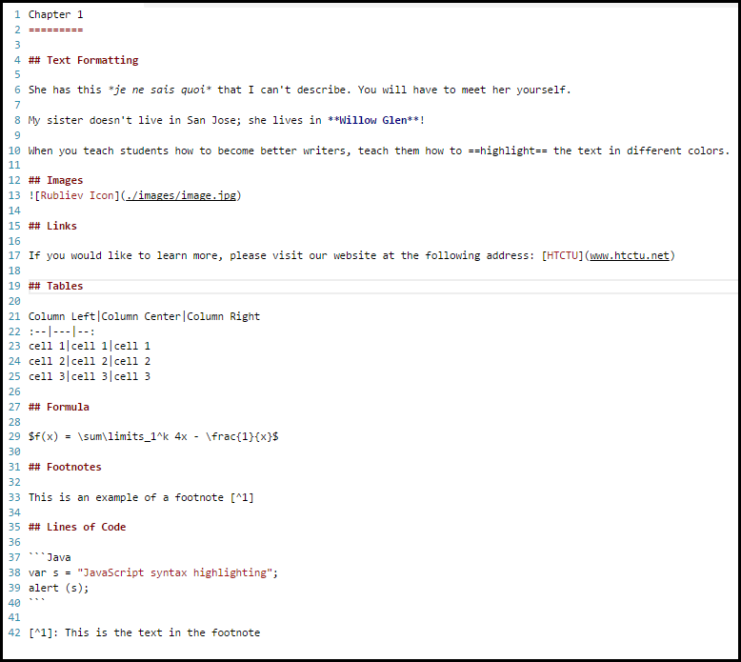
Markdown Example
Notes:
The color contrast of this slide is not ideal…use a different presentation mode…

Slide 7
The Benefits of Markdown
Simple to learn
“I always wanted to learn HTML…”
Easy to convert into other formats
PDF
HTML
EPUB
A good way of taking notes
Add semantic markup in a non-obtrusive way

Slide 8
How to Write Markdown
Use a cheat-sheet
https://tinyurl.com/md-syntax
Identify the Markdown syntax needed
e.g., a hashtag symbol (#) is for headings
Find an accessible text editor
Many on the macOS (e.g., MacDown)
One on the PC (e.g., Visual Code Studio)

Slide 9
Markdown Text Editors
Search for these features:
A preview window
Syntax highlighting
Shortcuts for adding Markdown syntax
Ability to convert to other formats (e.g., HTML)
A basic accessibility test:
Can the text editor region receive focus?
Can the HTML preview region receive focus?

Slide 10
Writing in Markdown
Basic Syntax and Note-taking Tips

Slide 11

Markdown Syntax - Tips
There are multiple Markdown flavors:
Github
Pandoc
Commonmark…and more
Check which Markdown flavor to use…
Check your Text Editor (e.g., see FAQ page)
Check your Conversion Tool (e.g., read the docs)
Babelmark 2 reveals interesting differences:
http://johnmacfarlane.net/babelmark2/
Notes:
https://github.com/commonmark/CommonMark/wiki/Markdown-Flavors

Slide 12
Markdown Headings
Use a # symbol
# = Heading 1
## = Heading 2
### = Heading 3
Example:
# My first Essay
## Introduction
This is the first paragraph of my essay.

Slide 13
Markdown Text Formatting
Italics
Use one asterisk (e.g., she is *Italian*)
Bold
Use two asterisks (e.g., she is **bold**.)
Underline
Use an underscore (e.g., She is _my_ sister.)
Strikethrough
Use two tildes (e.g., ~~Joshua~~came, too)
Highlight
Use two equal signs (e.g., She is ==good==.)

Slide 14
Markdown Images + Alt-Text
Use an !
Then brackets for alt-text
And parentheses for the path to the image
Example
! [alt-text](path/to/an/image.jpg)

Slide 15
Markdown Links
Links have two parts:
Place the text that will appear in brackets:
[wikipedia]
Then add the path to the website in parentheses:
(www.wikipedia.org)
Example:
I found the article on [wikipedia](www.wikipedia.org).

Slide 16
Markdown Tables
Use pipes to format tables¹
Insert a pipe between each column
Use a colon to indicate text alignment
e.g., a colon + two dashes indicates left alignment
Example:
columnA|column|column
:--|:--|:--
value1|value|value3
¹: There are other syntaxes as well

Slide 17

Markdown Math
Use LaTeX for Math
Use a single $ delimiter¹
We recommend WIRIS editor to write LaTeX
Example
Solve the problem:
1. $ f(x) = \sum\limits_1^k 4x - \frac{1}{x}$
¹Pandoc Markdown

Slide 18
Markdown Footnotes
Use brackets [ ]
And a caret ^
Then the number
Use the same syntax + a colon for the referent
Example:
John Gruber invented the Markdown syntax.[^1]
[^1]: www.wikipedia.org/Markdown.html

Slide 19
Note-Taking Strategies
Find a simple text editor
Live Preview
Move focus from Editor to Preview window
Teach keyboard shortcuts
Markdown syntax
Jump to preview window
Navigation shortcuts for AT
Teach how structure + formatting = easy review
Headings, lists, footnotes etc. = easier access
(e.g., screen reader users)

Slide 20
Alternate Formats
HTML, EPUB, and DOCX

Slide 21

Pandoc
Pandoc (2.1.1)
Uses Pandoc Markdown
Install on macOS, Windows, or Linux
E.g., brew install pandoc (macOS)
“Swiss Army Knife” converter (to many formats)
Basic command syntax
pandoc –o output.html –f input.md
Pandoc plug-ins available from text editors
vscode pandoc (Visual Studio Code Extension)

Slide 22

Setting Up Your Workflow
Create a folder directory:
Psychology_Book
Images
Image.jpg
01_Chapter.md
02_Chapter.md etc.
Metadata file (.TXT, .XML, .YML)
Remember to use relative path to images:
![alt-text](./images/textbook.png)

Slide 23
Markdown & Metadata
Add metadata in one of two ways:
Directly in Markdown file
As a YAML object in a .TXT file
Directly in Markdown document
% Title
% Author
% Date
As a YAML object in a .TXT file
Use --- at top of the file
Use … at bottom of the file
Notes:
Create a metadata document (we recommend using a Title.txt instead of the –metadata method because in this way the Cover the title page and the nav document follow the metadata from the Title text document
Check Markdown for page numbers
Export with Pandoc (epub2)
In the first document…the h1 is taken not from markdown but from the title.txt…need to change…
Clean up in Sigil
Delete the Nav Document
Use the Page-break clip tool (with the ARIA role and the ARIA label)
Add xml:lang attribute to each HTML file in the HTML header (find and replace all…no need for regex)
Add accessibility metadata in Package Document
Run PageList plug-in and then Export with EPUB3-itizer plug-inand run ACE report
Open Sigil and add ARIA role to new NAV document and add a Title

Slide 24

Markdown to HTML
HTML is the best export option
Least amount of editing afterwards
HTML files can be viewed easily in browsers
HTML + MathML ( or MathJax) = accessible math
HTML caveats:
Less used format by students
Consider page navigation markup

Slide 25
HTML Workflow
Scan / export as plain_text.md in chapters
Add % Book_Name at top of each document
Make sure “Page #” is at top of each page
Add Markdown syntax
Headings, Images + alt text, LaTeX for Math etc.
Add <h6> style before page numbers
sed –i ‘s/Page\ [0-9]*$/###### &/’ ./md
Use Pandoc to convert all MD files to HTML
Notes:
sed ‘s/Page\ [0-9]*$/###### &/’ ./path/to/file.md
find . –name \*.md –type f –exec sed ‘s/Page\ [0-9]*$/###### &/’ {} \;

Slide 26
Pandoc HTML Command
Pandoc CLI tips
Use –s for a standalone HTML
Use –toc to create a list of links to headings
Use –toc-depth= 6 if using <h6> for page numbers
Use –mathjax or –mathml or –webtext (PNG + alt-text)
Converting files to a single HTML file
pandoc –o single_file.html –s –mathjax ./*md
Exclude the metadata at the top of 2nd, 3rd etc. chapters
Avoid duplicates (e.g., foonotes, headings, etc.)
Converting files to separate HTML files
find . –name \*.md –type f –exec pandoc –toc –s –o {}.html –mathjax {} \;
Notes:
This convert into separate files command creates .html files that contain .md.html on them; to replace these, you can use the following command (macOS):
rename ‘s/.md.html/.html/g’ *.html

Slide 27
HTML Files Review
aXe Firefox toolbar
Right Click > Inspect Element > Developer Tools
Common errors
Color-contrast violations
Missing lang=“en” attribute
Missing aria landmarks (e.g., role=“main”)
Other tips
Use aria-label for footnotes’ return to text links

Slide 28

Markdown to EPUB
Benefits of EPUB conversion
Entire book can be navigated easily
Markdown is easier than InDesign ☺
EPUB books reflow to the size of mobile devices
Caveats of EPUB
Must check reading systems’ support for features:
E.g., MathML, Page-list Nav
Requires some “under the hood” editing
Adding accessibility metadata
Manual tagging of page numbers

Slide 29
EPUB Metadata
Use Title.txt with YAML metadata block:
Use --- at beginning of file
Use … at end of file
Possible metadata
Title:
Author:
Rights:
Date:
Language:
Source:
Publisher:
Notes:
See pandoc.org/MANUAL.html#epub-metadata
Important to use the Source Metadata entry for referring to print version

Slide 30
EPUB Workflow
Scan/ export to plain_text.md in chapters
Create YAML document with metadata
Add a cover.jpg file (e.g., college logo)
Make sure “Page #” is at top of each page
Add Markdown syntax
Headings, Images + alt text, LaTeX for Math etc.
Use Pandoc to convert all files to EPUB¹
¹ EPUB2 or EPUB3 options available

Slide 31
Pandoc EPUB Command
Pandoc CLI tips
--epub3 switch will convert LaTeX to MathML
Use –epub2 in workflow to create page-list Nav
Use –webtex to convert LaTeX to images + alt text
Converting Markdown files to an EPUB
pandoc –o mybook.epub Title.txt–epub-cover-image=cover.jpg ./*.md –toc –toc-depth=2

Slide 32
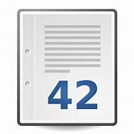
EPUB Page Numbers
Use –epub2 in Pandoc command
Sigil workflow:
Delete the Nav document
Use clips tool to add page-break
Run PageList¹ plug-in
Export with EPUB3-itizer² plug-in
¹Page-list will update your NCX file
²EPUB3-itizer will convert NCX →NAV file with a “page-list” toc
Notes:
Using Sigil..only use the clip around the number of the Page number…not page
Pandoc generates a NAV document even when exporting to EPUB2 and this creates a title that is the same as the markdown document…
A second nav document is being created when using the EPUB3-itizer…it contains no text in the title tag consider deleting the NAV document when exporting to EPUB2 with pandoc? (WELL maybe this was because I ran EPUB3-itizer another time…which automatically generates another NAV document)
One needs to ARIA labels to every pagebreak location:
<span role=“doc-pagebreak” id=“pg24” aria-label=“24”>
Consider adding this to the clip… feature…
One needs to add the dc:source meta element to the package document when referring to a print page book…
The title page takes the name of the first markdown document…and this name is added to the metadata in the Package document…check how to fix this…
When testing the EPUB (Which passed the ACE test) with Vital Source…it says “horizontal splitter”)

Slide 33
EPUB Review
Use the ACE accessibility checker
https://github.com/daisy/ace
Checks against EPUB standard + WCAG 2.0 AA
Use Sigil EPUB editor to make your edits
The errors we have encountered most…
Missing accessibility metadata
Mapping epub:type to ARIA roles
Adding xml:lang attribute in <html> element
Empty <title> element in nav.xhtml document

Slide 34

Markdown to DOCX
Benefits include:
More familiar format
Intermediate step for PDF creation
LaTeX is converted into OMML equations
Caveats
Pandoc-filter necessary for page-breaks
pandoc-docx-pagebreak

Slide 35
DOCX Workflow
Scan/ export to plain_text.md in chapters
Add % Book_Title at top of first chapter
Make sure “Page #” is at top of each page
Add “PAGEBREAK” on line before Page #
Add Markdown syntax
Headings, Images + alt text, LaTeX for Math etc.
Add <h6> style before page numbers
sed –i ‘s/Page\ [0-9]*$/###### &/’ ./md
Use Pandoc to convert all MD files to DOCX

Slide 36
Pandoc DOCX command
pandoc-docx-pagebreak pandoc filter
Must install separately
Helps in a PDF workflow
Use for landscape orientation (e.g., wide tables)
Creating separate chapter files:
find . –name \*.md –type f –exec pandoc –filter pandoc-docx-pagebreak –s –o {}.docx {} \;
If you are combining files into a single DOCX…
Add metadata 1x and use H2 for chapter names
Don’t duplicate footnote numbers, heading names

Slide 37

DOCX Review
Additional MS Word Accessibility
Check for proper styles
Add “Repeat Header Row” in Table Properties
Convert MS Word equations to MathType equations
Use Save as Adobe PDF add-on (MS Word)
Add-in available on the PC
Check tags tree in Adobe Acrobat for the following:
table headers,
links to footnotes,
Headings for page numbers
Notes:
Macintosh Save as PDF option can be used to create a tagged PDF but some features in the WORD document do not convert (e.g., links)

Slide 38
Other Resources
Open-Source Tools & Apps

Slide 39

AGSBS-Infrastructure
Install CLI tool (github)
Atom Package available
Benefits:
Creates a folder structure
Creates a table of contents file
Adds links to page numbers in each HTML file
Creates separate HTML files for Complex Images
Multiple profiles: blind, low-vision
Caveats
German documentation; Atom is inaccessible ☹

Slide 40

App Recommendations
Byword (iOS)
$5.99 at Apple Store
Preview Markdown
Export to HTML and PDF
On-screen Keyboard shortcuts
iA Writer (iOS)
$4.99 at Apple Store
Synchronized Preview
Excellent Markdown shortcuts
Export to DOCX, HTML, and PDF

